Slide 1
Depression in Relationships
Magazine Article

Slide 2
The Real Picture of Most Relationships
Depression has become prevalent among various couples.
Couples do not know how they met.
Sadness prevails in most relationships.
Many individuals in relationships often regard themselves as single.
Couples have ceased talking to each other.
Many relationships have deteriorated since couples are not ready to swallow their pride.

Slide 3
Cont.
Couples do not exchange pleasantries nowadays.
Saying "hello" or "good morning" has become rare in most relationships.
Couples feel that they have better things to do.
Wives do not know the professions of their husbands so long as there is food in the table.
Relationships are nowadays materially-centered.
They only thrive when material benefits are sustainable.
Material items provide more joy to couples than the individuals themselves.
Material pleasures have replaced human affection in most relationships.

Slide 4
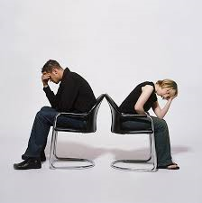
Cont.
Ultimately, most couples harbor suicidal thoughts.
Most people do not shy away from taking pills to end their lives.

